Slide 1
Assignment – Support Vector Machine (SVM)
Submitted By: Pooran Pragnya
November Batch (BDS)

Slide 2
SUPPORT VECTOR MACHINE (SVM)
It is the most popular supervised leaning algorithm, which is used for classification as well as regression problems. However, primarily used for classification problems in machine learning.
The SVM algorithm helps to find the best line/decision boundary called hyperplane that classifies the data points.
The SVM chooses the extreme points/vectors that help in creating the hyperplane/Decision boundary. These extreme cases are called as support vectors, hence the algorithm is termed as Support Vector Machine.

Slide 3
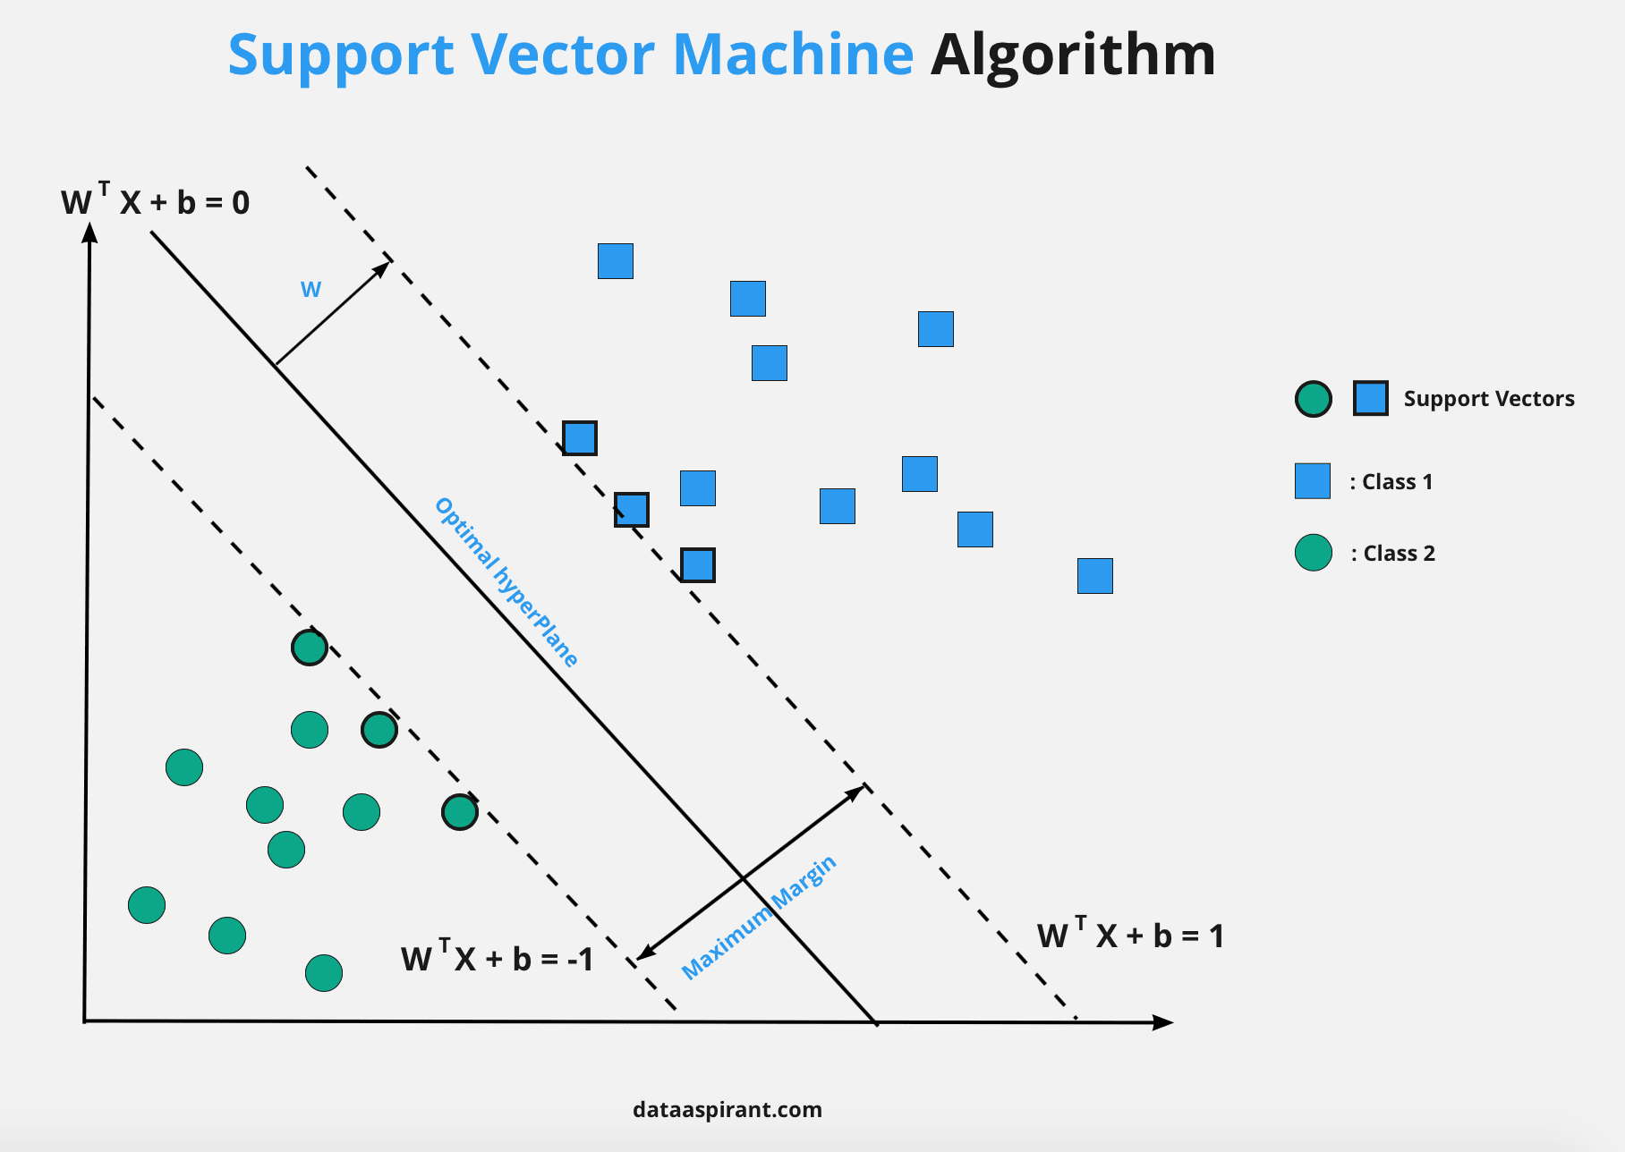

Slide 4
Terminologies used in SVM
1. Hyper plane: It is the best line/decision boundary that classifies the data points. We always create a hyperplane that has a maximum margin, which means the maximum distance between the datapoints.
The hyperplane with maximum margin is called Optimal Hyperplane.
2. Margin: The Distance between the Support vectors and the hyperplane is called a Margin and the goal of SVM is to maximize this margin.
3. Support Vectors: The datapoints/vector that are closest to the hyperplane are called support Vectors

Slide 5
Objective of SVM:
The objective of SVM algorithm is to find a hyperplane in a N-Dimensional space that distinctly classifies the data points.
The dimension of hyperplane depends upon the number of features. If the number of input features are two, then hyperplane is just a line. If the input features are three, then hyperplane becomes 2-Dimensional plane.
It becomes difficult to imagine when the number of features exceeds three.

Slide 6
Types of SVM:
1. Linear SVM (LSVM): It is used for linearly separable data, which means if a dataset can be classified into two classes by using single straight line then such data is termed as linearly separable data and classifier is used is called as Linear SVM classifier.

Slide 7
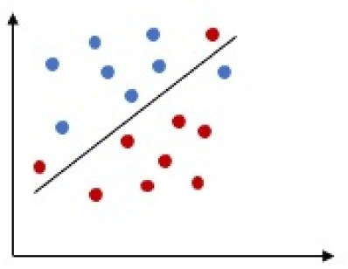
2. Non-Linear SVM (NLSVM): it is used for non-linearly separated data, which means if a dataset cannot be classified by using a straight line, then such data is termed as non-linear data and classifier used is called as non-linear SVM classifier. Kernels are used for this purpose.

Slide 8
Kernel Trick/ Kernel Function:
A Kernel transforms a low dimensional input data space into a higher dimensional space.
It converts non-linear separable problems to linear separable problems by adding more dimension to it. Thus the Kernel trick helps us to build a more accurate classifier, hence it is useful in non-linear separation problems.
In the context of SVMs, there are 4 popular Kernels namely Linear Kernel, Polynomial Kernel, Radial Bias function Kernel (RBF) (also called as Gaussian Kernel) and Sigmoid Kernel.

Slide 9
Kernel Function will convert one-dimensional NLSVM into two- dimensional or two-dimensional into three-dimensional NLSVM then fits hyperplane and converts into LSVM.
Hyperplane
Kernel Function
Kernel Function
Hyperplane

Slide 10
Advantages of SVM:
SVM is very effective even with high dimensional data.
When you have dataset where number of features is more than number of rows of data, SVM can perform in that case as well.
It can be used for both classification as well as regression problems.
SVM can work even well with image data as well.

Slide 11
Limitations of SVM:
When overlapping classes of datapoints are present, it doesn’t performs well.
Choosing a optimal kernel for SVM is bit difficult.
Takes more time to train the data in case of big data.
It is difficult to understand and interpret the SVM Model compared to decision tree as SVM is more complex.

Slide 12
Application of SVM
Face Detection (face and non face and creates a square boundary around the face).
It is used in text and hypertext categorization.
It uses training data to classify documents into different categories such as news articles, emails and web pages.
It finds application in Geo-spatial data based applications (GIS, RS)

